Slide 1



Data Science
Foundations
Master in Big Data Solutions 2017-2018
Francisco Gutierres
francisco.gutierres@bts.tech
Ludovico Boratto
ludovico.boratto@bts.tech
Liana Napalkova
liana.napalkova@bts.tech
Barcelona Technology School S.L.

Slide 2
Session 8 – Probability distributions
Francisco Gutierres

Slide 3

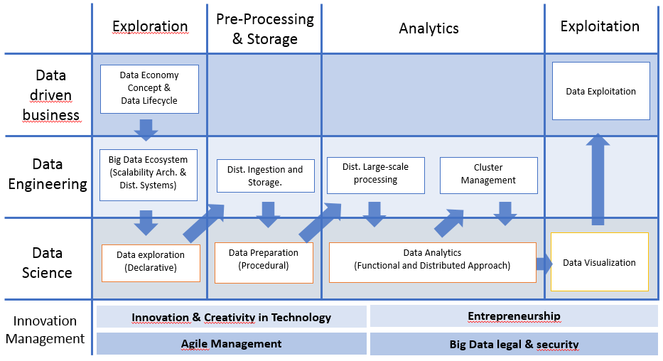
What we will learn
Session8:
Descriptive Statistics
Introduction to Probability distributions using Pandas, Numpy, Scipy, Random, Math and Matplotlib libraries.
We will learn how to:
Implement of several Phyton libraries (Pandas, Numpy, Scipy, Random, Math and Matplotlib) to perform Probability distributions using DataFrames.

Slide 4
Today’s Objective
What will we learn today?
How to perform Probability distributions.
How to interpret results.

Slide 5

Contents
I. Activities in the class (Demos and Exercises)
II. Individual Assignment (will be explained at the end of the class)
Use a Pandas DataFrame with food type rantings:
Perform Conditional probability.
Commit scripts to your Git.
Create your repository “DataScienceFoundations”.

Slide 6
What is Conditional Probablity?
The concept of conditional probability is one of the most fundamental and one of the most important concepts in probability theory.
Conditional probability is a measure of the probability of an event given that (by assumption, presumption, assertion or evidence) another event has occurred.
If the event of interest is A and the event B is known or assumed to have occurred, "the conditional probability of A given B", or "the probability of A under the condition B", is usually written as P(A|B), or sometimes PB(A).
For example, the probability that any given person has a cough on any given day may be only 5%. But if we know or assume that the person has a cold, then they are much more likely to be coughing. The conditional probability of coughing given that you have a cold might be a much higher 75%.
But conditional probabilities require careful interpretation. For example, there need not be a causal or temporal relationship between A and B. In general, P(A|B) (the conditional probability of A given B) is not equal to P(B|A).
For example, if you have cancer you might have a 90% chance of testing positive for cancer. In this case what is being measured is that if event B ("having cancer") has occurred, the probability of A (test is positive) given that B (having cancer) occurred is 90%: that is, P(A|B) = 90%.
Alternatively, if you test positive for cancer you may have only a 15% chance of actually having cancer because most people do not have cancer and the false positive rate for the test may be high. In this case what is being measured is the probability of the event B (having cancer) given that the event A (test is positive) has occurred: P(B|A) = 15%.

Slide 7
What is Conditional Probablity?
Example:
company model rating type
0 ford mustang A coupe
1 chevy camaro B coupe
2 ford fiesta C sedan
3 ford focus A sedan
4 ford taurus B sedan
5 toyota camry B sedan
Output1:
Prob(rating=A) = 0.333333
Prob(rating=B) = 0.500000
Prob(rating=C) = 0.166667
Output2:
Prob(type=coupe|rating=A) = 0.500000
Prob(type=sedan|rating=A) = 0.500000
Prob(type=coupe|rating=B) = 0.333333
Prob(type=sedan|rating=B) = 0.666667
Prob(type=coupe|rating=C) = 0.000000
Prob(type=sedan|rating=C) = 1.000000

Slide 8
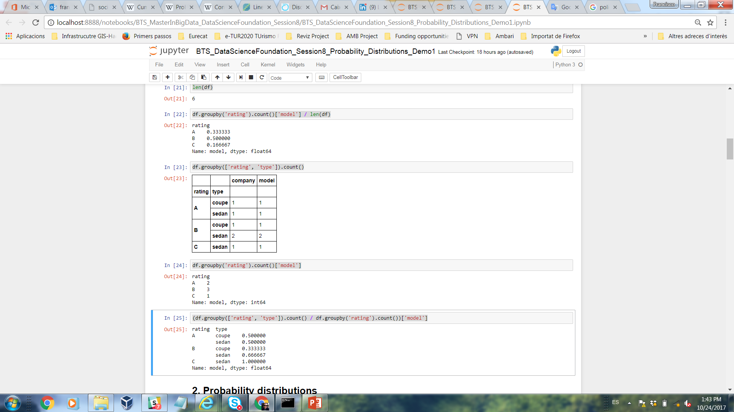
What is Conditional Probablity?
Lets do in Pandas:
import pandas as pd
import numpy as np
%matplotlib inline
Create the dataframe:
data = {'company': ['ford', 'chevy', 'ford', 'ford', 'ford', 'toyota'],
'model': ['mustang', 'camaro', 'fiesta', 'focus', 'taurus', 'camry'],
'rating': ['A', 'B', 'C', 'A', 'B', 'B'],
'type': ['coupe', 'coupe', 'sedan', 'sedan', 'sedan', 'sedan']}
df = pd.DataFrame(data, columns = ['company', 'model', 'rating', 'type'])
df
Output 1:
df.groupby('rating').count()['model']
len(df)
df.groupby('rating').count()['model'] / len(df)

Slide 9
What is Conditional Probablity?
Output 2:
df.groupby(['rating', 'type']).count()
df.groupby('rating').count()['model']
(df.groupby(['rating', 'type']).count() / df.groupby('rating').count())['model']

Slide 10
What is Probability Distributions?
Many statistical tools and techniques used in data analysis are based on probability.
Probability measures how likely it is for an event to occur on a scale from 0 (the event never occurs) to 1 (the event always occurs.).
Probability distribution it is a general term to indicate the way the total probability of 1 is distributed over all various possible outcomes (i.e. over entire population)
When working with data, variables in the columns of the data set can be thought of as random variables: variables that vary due to chance.
A probability distribution describes how a random variable is distributed; it tells us which values a random variable is most likely to take on and which values are less likely.
Probability distributions are generally divided into: continuous or discrete, non-cumulative or cumulative.

Slide 11
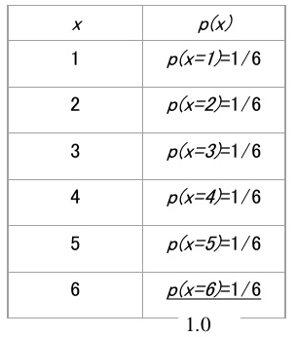
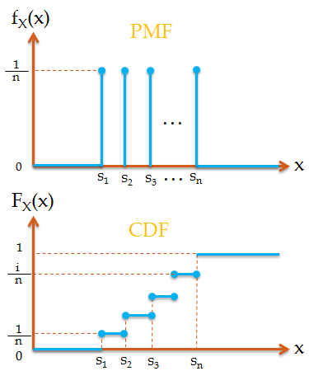
Discrete Probability Distributions?
A discrete probability distribution (applicable to the scenarios where the set of possible outcomes is discrete, such as a coin toss) can be encoded by a discrete list of the probabilities of the outcomes, known as a Probability Mass Function (PMF).
Probability Mass Function (PMF) - Discrete probability distribution function: for discrete random variables.

Slide 12
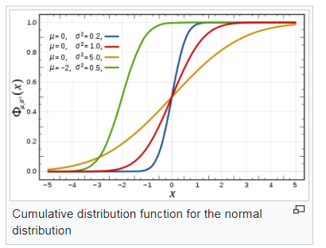
Cumulative Distribution Function?
Many statistical tools and techniques used in data analysis are based on probability.
Cumulative distribution function: is a general functional form to describe a probability distribution.
The cumulative distribution function (CDF) of a real-valued random variable X, or just distribution function of X, evaluated at x, is the probability that X will take a value less than or equal to x.
In the case of continuous distribution, it gives the area under the probably density function from minus to X.

Slide 13
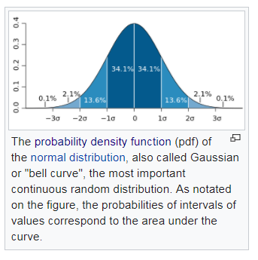
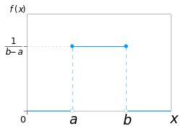
Continuous Probability Distributions?
On the other hand, a continuous probability distribution (applicable to the scenarios where the set of possible outcomes can take on values in a continuous range (e.g. real numbers), such as the temperature on a given day) is typically described by Probability Density Functions (PDF) (with the probability of any individual outcome actually being 0).
Probability Density Functions (PDF) - Continuous probability distribution function: most often reserved for continuous random variables.
The normal distribution is a commonly encountered continuous probability distribution.
Continuous uniform distribution is a family of symmetric probability distributions, all intervals of the same length on the distribution's support are equally probable.

Slide 14
Demos

Slide 15
Demo 1
Objective: Mastering skills about Probability Distributions.
Phyton libraries for Descriptive Statistics: Pandas, numpy and Matplotlib.
Create a new notebook and put your code in the final.
Export your Demo 1 *.ipynb notebook and push it to your repository “DataScienceFoundations”.
1. The Uniform Distribution - The uniform distribution is a probability distribution where each value within a certain range is equally likely to occur and values outside of the range never occur.
Every one of n values has equal probability 1/n.
Import modules
%matplotlib inline
import numpy as np
import pandas as pd
import matplotlib.pyplot as plt
import scipy.stats as stats

Slide 16
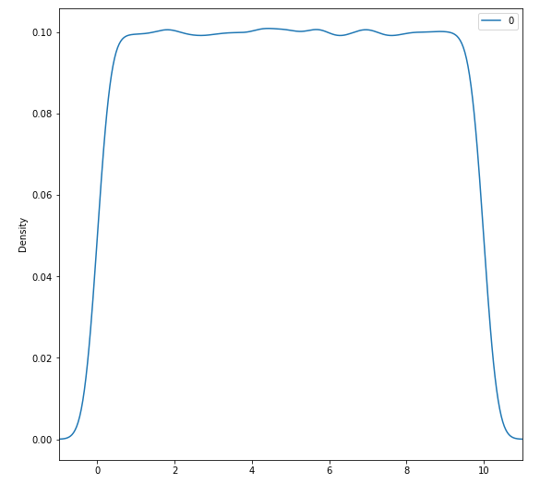
Demo 1
Create the uniform distribution
uniform_data = stats.uniform.rvs(size=100000, # Generate 100000 numbers
loc = 0, # From 0
scale=10) # To 10
- stats.distribution.rvs() generates random numbers from the specified distribution. The arguments to rvs() will vary depending on the type of distribution you're working with; in the case of the uniform distribution, we have to specify the starting and ending points and the size (number of random points to generate.).
Plot the uniform distribution
pd.DataFrame(uniform_data).plot(kind="density", # Plot the distribution
figsize=(9,9),
xlim=(-1,11))

Slide 17
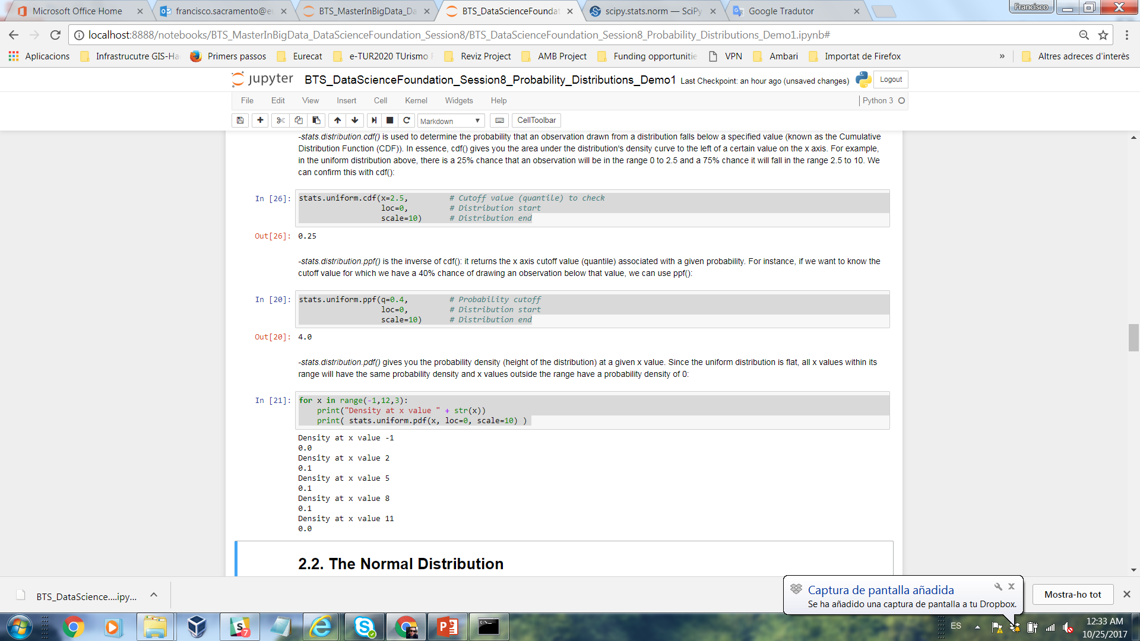
Demo 1
1.1. Random data and extracting values of interest
Python also comes with a library called "random" that lets you perform various operations that involve randomization. Let's look at a few functions in the random library:
import random
random.randint(0,10) # Get a random integer in the specified range
random.choice([2,4,6,9]) # Get a random element from a sequence
random.random() # Get a real number between 0 and 1
random.uniform(0,10) # Get a real in the specified range
1.2. The Cumulative Distribution
stats.distribution.cdf() is used to determine the probability that an observation drawn from a distribution falls below a specified value (known as the Cumulative Distribution Function (CDF)).
stats.uniform.cdf(x=2.5, # Cutoff value (quantile) to check
loc=0, # Distribution start
scale=10) # Distribution end

Slide 18
Demo 1
1.3. The Inverse of Cumulative Distribution
- stats.distribution.ppf() is the inverse of cdf(): it returns the x axis cutoff value (quantile) associated with a given probability. For instance, if we want to know the cutoff value for which we have a 40% chance of drawing an observation below that value, we can use ppf():
stats.uniform.ppf(q=0.4, # Probability cutoff
loc=0, # Distribution start
scale=10) # Distribution end
1.4. Probability density
stats.distribution.pdf() gives you the probability density (height of the distribution) at a given x value. Since the uniform distribution is flat, all x values within its range will have the same probability density and x values outside the range have a probability density of 0:
for x in range(-1,12,3):
print("Density at x value " + str(x))
print( stats.uniform.pdf(x, loc=0, scale=10) )

Slide 19
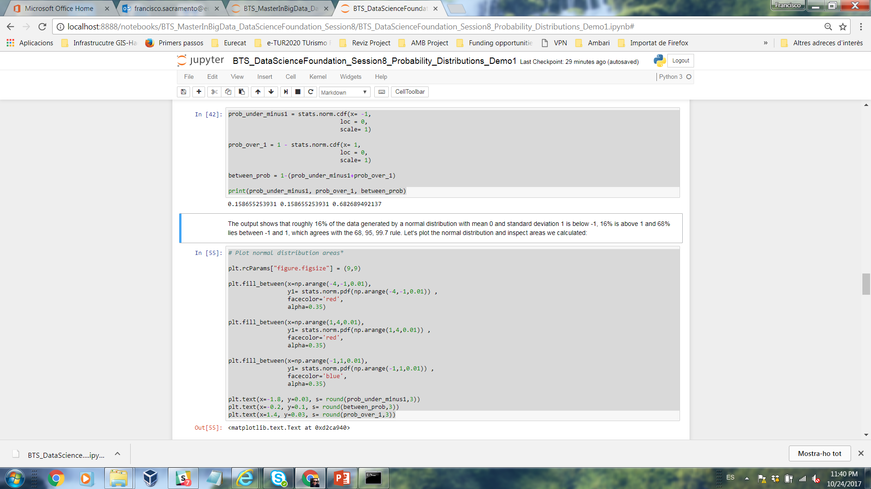
Demo 1
2. The Normal Distribution
The normal or Gaussian distribution is a continuous probability distribution characterized by a symmetric bell-shaped curve. A normal distribution is defined by its center (mean) and spread (standard deviation.). The bulk of the observations generated from a normal distribution lie near the mean, which lies at the exact center of the distribution: as a rule of thumb, about 68% of the data lies within 1 standard deviation of the mean, 95% lies within 2 standard deviations and 99.7% lies within 3 standard deviations.
prob_under_minus1 = stats.norm.cdf(x= -1,
loc = 0,
scale= 1)
prob_over_1 = 1 - stats.norm.cdf(x= 1,
loc = 0,
scale= 1)
between_prob = 1-(prob_under_minus1+prob_over_1)
print(prob_under_minus1, prob_over_1, between_prob)
The output shows that roughly 16% of the data generated by a normal distribution with mean 0 and standard deviation 1 is below -1, 16% is above 1 and 68% lies between -1 and 1, which agrees with the 68, 95, 99.7 rule.

Slide 20
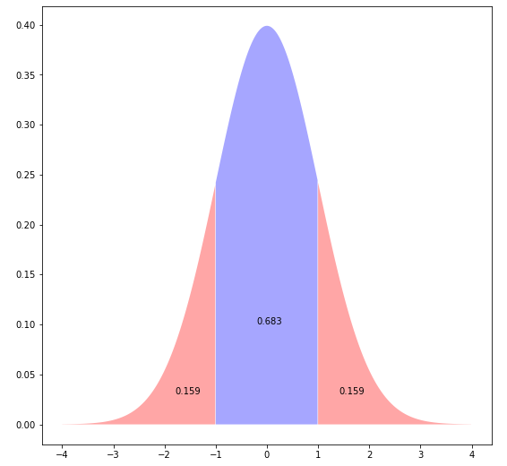
Demo 1
2. The Normal Distribution
Plot the normal distribution and inspect areas we calculated:
# Plot normal distribution areas*
plt.rcParams["figure.figsize"] = (9,9)
plt.fill_between(x=np.arange(-4,-1,0.01),
y1= stats.norm.pdf(np.arange(-4,-1,0.01)) ,
facecolor='red',
alpha=0.35)
plt.fill_between(x=np.arange(1,4,0.01),
y1= stats.norm.pdf(np.arange(1,4,0.01)) ,
facecolor='red',
alpha=0.35)
plt.fill_between(x=np.arange(-1,1,0.01),
y1= stats.norm.pdf(np.arange(-1,1,0.01)) ,
facecolor='blue',
alpha=0.35)
plt.text(x=-1.8, y=0.03, s= round(prob_under_minus1,3))
plt.text(x=-0.2, y=0.1, s= round(between_prob,3))
plt.text(x=1.4, y=0.03, s= round(prob_over_1,3))
The plot shows the bell shape of the normal distribution, the area below and above one standard deviation and the area within 1 standard deviation of the mean.

Slide 21
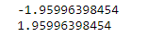
Demo 1
2. The Normal Distribution
Finding quantiles of the normal distribution is a common task when performing statistical tests. You can check normal distribution quantiles with stats.norm.ppf():
print( stats.norm.ppf(q=0.025) ) # Find the quantile for the 2.5% cutoff
print( stats.norm.ppf(q=0.975) ) # Find the quantile for the 97.5% cutoff
The quantile output above confirms that roughly 5% of the data lies more than 2 standard deviations from the mean.
We use a range between two quantiles, usually the 2.5 centile and the 97.5 centile, which is called the normal range, 95% reference range, or 95% reference interval.
This leaves 5% of normals outside the `normal range'.
*Note: a mean of 0 and standard deviation of 1 are default values for the normal distribution.

Slide 22
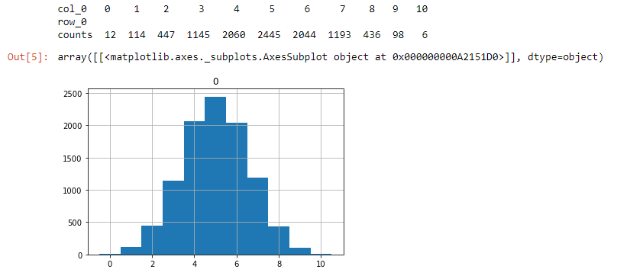
Demo 1
3. The Binomial Distribution
fair_coin_flips = stats.binom.rvs(n=10, # Number of flips per trial
p=0.5, # Success probability
size=10000) # Number of trials
print( pd.crosstab(index="counts", columns= fair_coin_flips))
pd.DataFrame(fair_coin_flips).hist(range=(-0.5,10.5), bins=11)

Slide 23
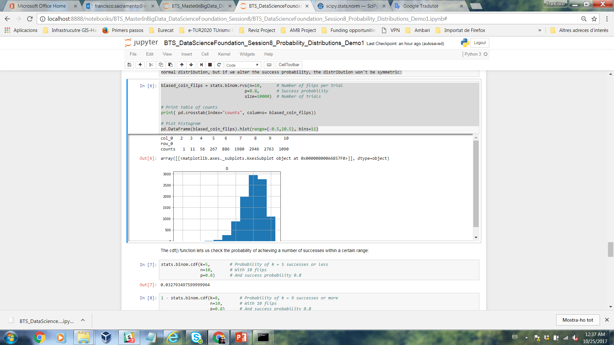
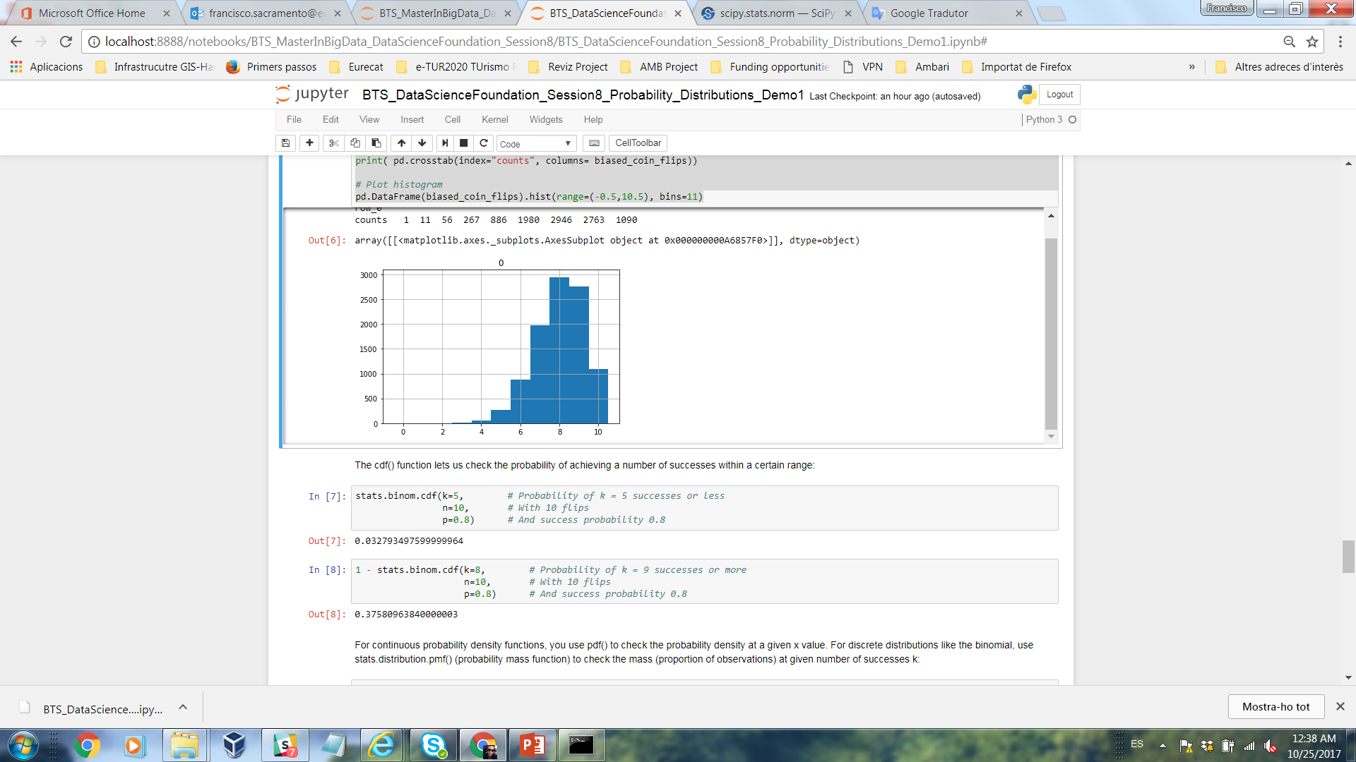
Demo 1
3. The Binomial Distribution
Note that since the binomial distribution is discrete, it only takes on integer values so we can summarize binomial data with a frequency table and its distribution with a histogram.
The histogram shows us that a binomial distribution with a 50% probability of success is roughly symmetric, with the most likely outcomes lying at the center. This is reminiscent of the normal distribution, but if we alter the success probability, the distribution won't be symmetric:
biased_coin_flips = stats.binom.rvs(n=10, # Number of flips per trial
p=0.8, # Success probability
size=10000) # Number of trials
# Print table of counts
print( pd.crosstab(index="counts", columns= biased_coin_flips))
# Plot histogram
pd.DataFrame(biased_coin_flips).hist(range=(-0.5,10.5), bins=11)

Slide 24
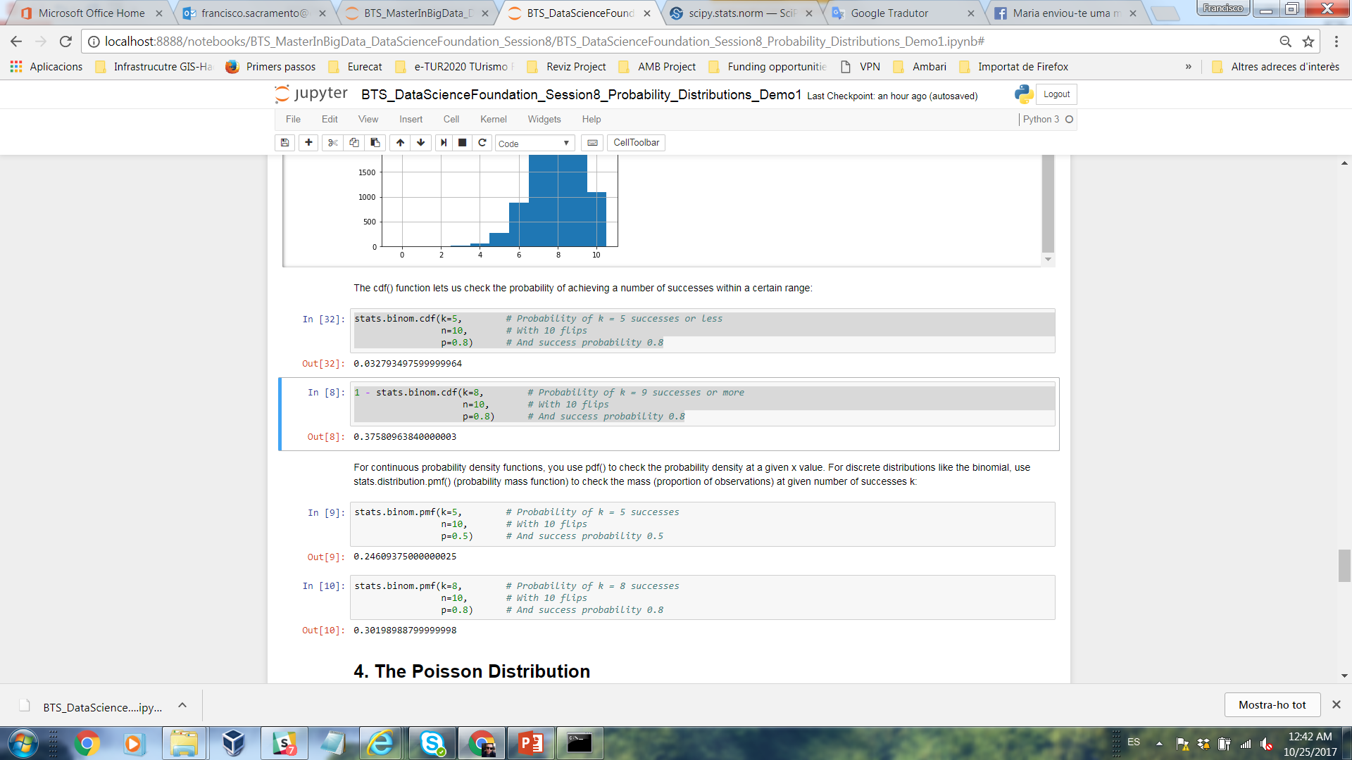
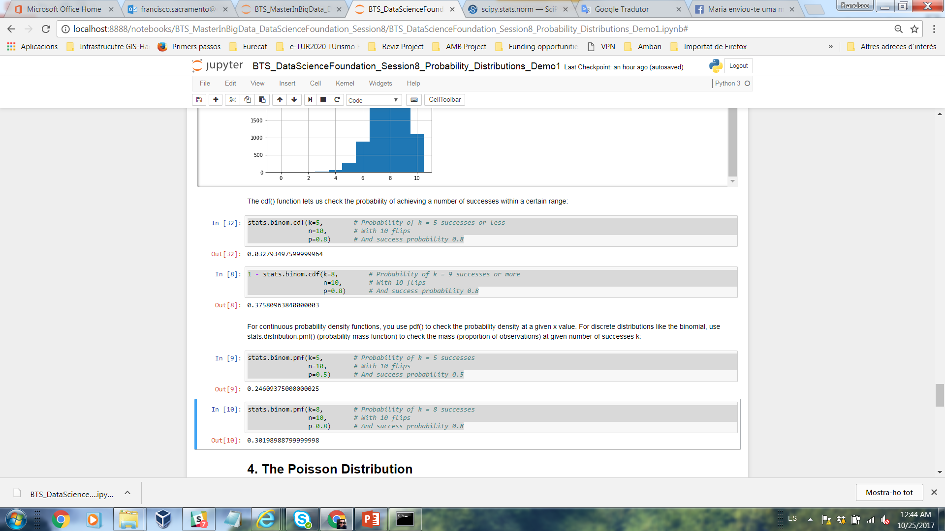
Demo 1
3. The Binomial Distribution
The cdf() function lets us check the probability of achieving a number of successes within a certain range:
stats.binom.cdf(k=5, # Probability of k = 5 successes or less
n=10, # With 10 flips
p=0.8) # And success probability 0.8
1 - stats.binom.cdf(k=8, # Probability of k = 9 successes or more
n=10, # With 10 flips
p=0.8) # And success probability 0.8
For continuous probability density functions, you use pdf() to check the probability density at a given x value. For discrete distributions like the binomial, use stats.distribution.pmf() (probability mass function) to check the mass (proportion of observations) at given number of successes k:
stats.binom.pmf(k=5, # Probability of k = 5 successes
n=10, # With 10 flips
p=0.5) # And success probability 0.5
stats.binom.pmf(k=8, # Probability of k = 8 successes
n=10, # With 10 flips
p=0.8) # And success probability 0.8

Slide 25
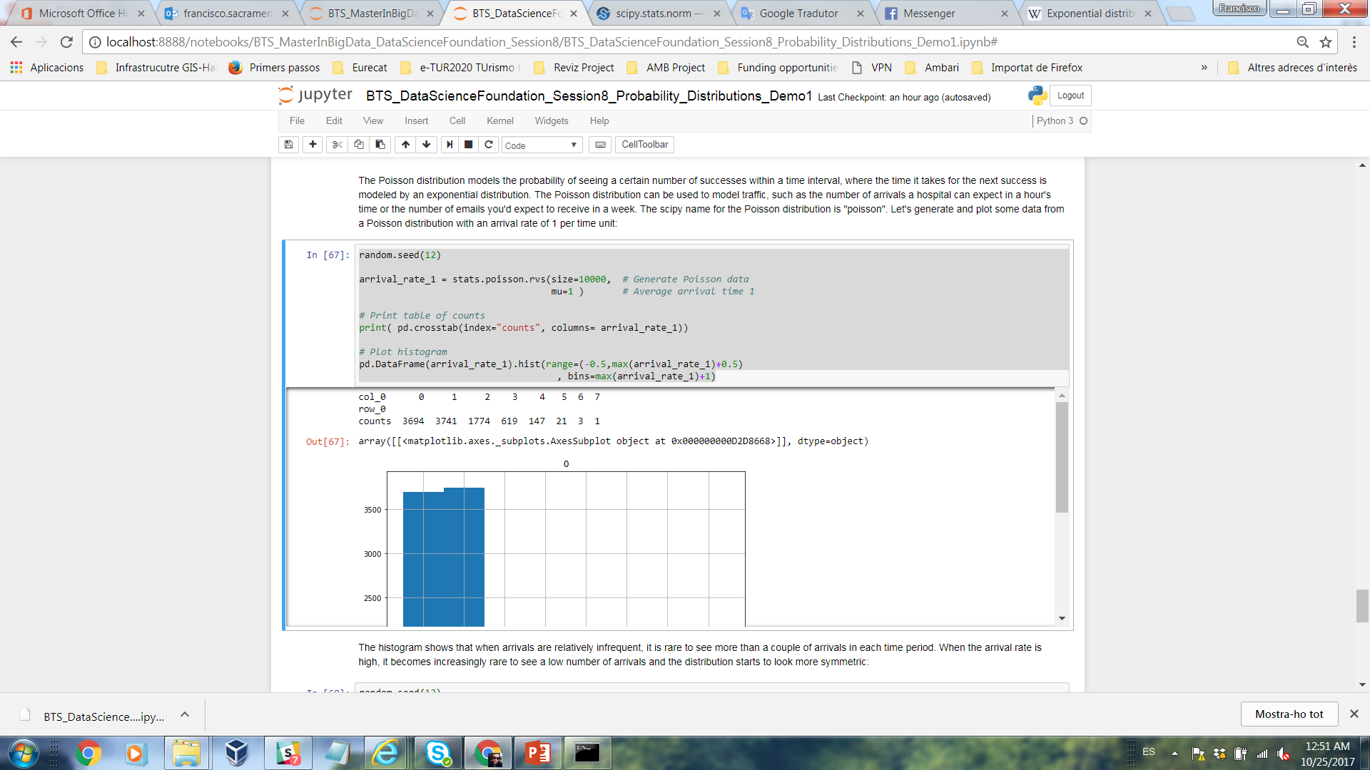
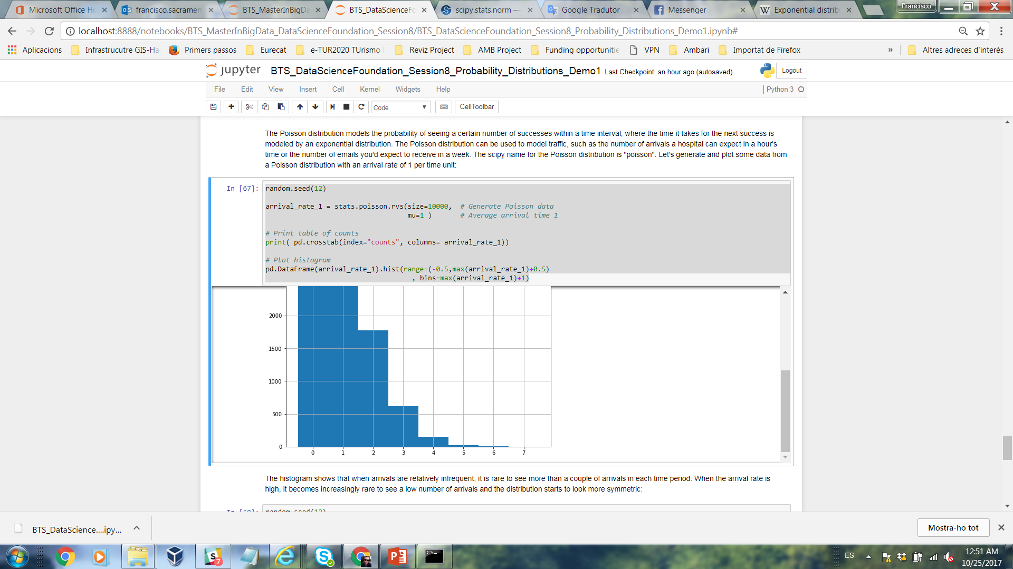
Demo 1
4. The Poisson Distribution
The Poisson distribution models the probability of seeing a certain number of successes within a time interval, where the time it takes for the next success is modeled by an exponential distribution. A process in which events occur continuously and independently at a constant average rate. The Poisson distribution can be used to model traffic, such as the number of arrivals a hospital can expect in a hour's time.
random.seed(12) # The seed number you choose is the starting point used in the generation of a sequence of random numbers
arrival_rate_1 = stats.poisson.rvs(size=10000, # Generate Poisson data
mu=1 ) # Average arrival time 1
# Print table of counts
print( pd.crosstab(index="counts", columns= arrival_rate_1))
# Plot histogram
pd.DataFrame(arrival_rate_1).hist(range=(-0.5,max(arrival_rate_1)+0.5)
, bins=max(arrival_rate_1)+1)

Slide 26
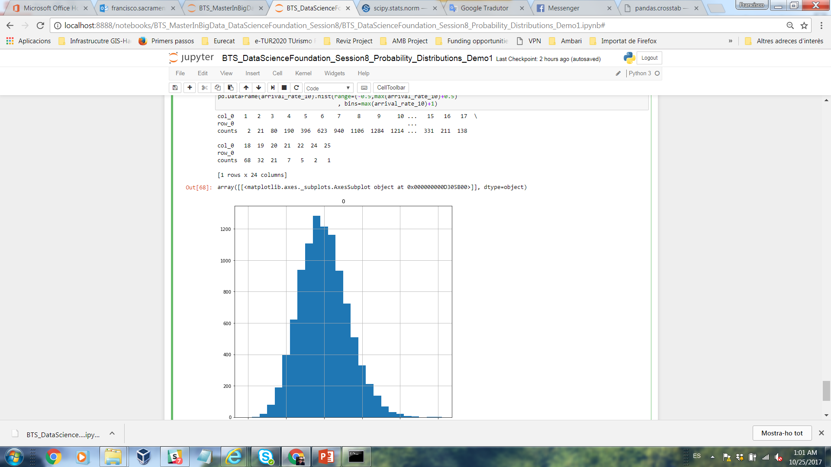
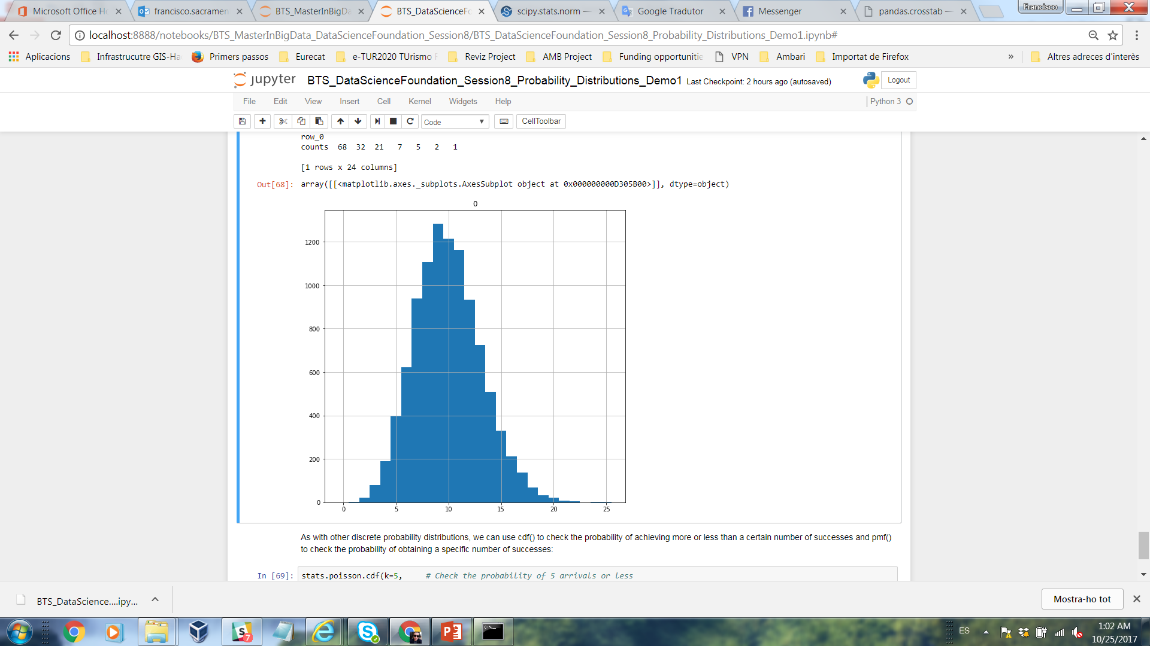
Demo 1
4. The Poisson Distribution
The histogram shows that when arrivals are relatively infrequent, it is rare to see more than a couple of arrivals in each time period. When the arrival rate is high, it becomes increasingly rare to see a low number of arrivals and the distribution starts to look more symmetric:
random.seed(12)
arrival_rate_10 = stats.poisson.rvs(size=10000, # Generate Poisson data
mu=10 ) # Average arrival time 10
# Print table of counts
print( pd.crosstab(index="counts", columns= arrival_rate_10))
# Plot histogram
pd.DataFrame(arrival_rate_10).hist(range=(-0.5,max(arrival_rate_10)+0.5)
, bins=max(arrival_rate_10)+1)

Slide 27
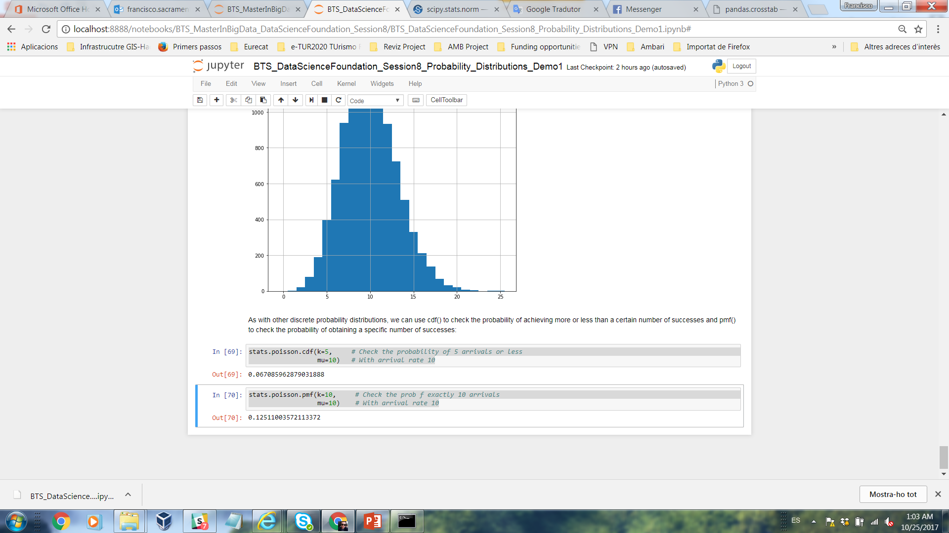
Demo 1
4. The Poisson Distribution
As with other discrete probability distributions, we can use cdf() to check the probability of achieving more or less than a certain number of successes and pmf() to check the probability of obtaining a specific number of successes:
stats.poisson.cdf(k=5, # Check the probability of 5 arrivals or less
mu=10) # With arrival rate 10
stats.poisson.pmf(k=10, # Check the prob f exactly 10 arrivals
mu=10) # With arrival rate 10

Slide 28
Demo 2
Objective: Mastering skills about Sampling Distributions and The Central Limit Theorem.
Phyton libraries for Descriptive Statistics: Pandas, Numpy, Scipy, Random, Math and Matplotlib.
Clone the Git repository to get an initial code:
Create a new notebook and put your code in the final.
Export your Demo 2 *.ipynb notebook and push it to your repository “DataScienceFoundations”.

Slide 29
Demo 3
Objective: Mastering skills about Hypothesis Testing Basics.
Phyton libraries for Descriptive Statistics: Pandas, Numpy, Scipy, Random, Math and Matplotlib.
Clone the Git repository to get an initial code:
Create a new notebook and put your code in the final.
Export your Demo 3 *.ipynb notebook and push it to your repository “DataScienceFoundations”.

Slide 30
Class Exercices

Slide 31
Exercise 1
Exercise 1 - Probability distributions
Considering the Sampling Distributions and The Central Limit Theorem in Demo 2 develop the confidence intervals for the distribution of Population heights Catalunya.
Interpret and discuss the Results.
Commit scripts in your GitHub account. You should export your solution code (.ipynb notebook) and push it to your repository “DataScienceFoundations”.
The following are the tasks that should complete and synchronize with your repository “DataScienceFoundations” until November 06. Please notice that none of these tasks is graded, however it’s important that you correctly understand and complete them in order to be sure that you won’t have problems with further assignments.
Guidelines:
Clone the Git repository to get an initial code:
https://github.com/FGutierresBTS/BTS_MasterInBigData.git
Once you downloaded the repository to your local file system, go to the folder “BTS_MasterInBigData/Session_8_DSF”.
Copy the folder “Session_8_DSF” into your local folder “DataScienceFoundations”.
In the folder “Session_8_DSF” you will see the files called:
- BTS_DataScienceFoundation_Session8_Probability_Distributions_Exercise1.ipynb
Import these files into Jupyter Notebook using the “Upload” button.
Open the imported script and put your code inside the notebook.
Export your Exercise1 *.ipynb notebook and push it to your repository “DataScienceFoundations”. Also in “Teams/Assignments” section.

Slide 32
Exercise 2
Exercise 2 - “Hypothesis Testing Basics - One-Sample test
Considering the Hypothesis Testing Basics in Demo 3 develop the Hypothesis Tests for the distribution of Population and Sample heights of Spain and Catalunya.
Interpret and discuss the Results.
Commit scripts in your GitHub account. You should export your solution code (.ipynb notebook) and push it to your repository “DataScienceFoundations”.
The following are the tasks that should complete and synchronize with your repository “DataScienceFoundations” until November 06. Please notice that none of these tasks is graded, however it’s important that you correctly understand and complete them in order to be sure that you won’t have problems with further assignments.
Guidelines:
Clone the Git repository to get an initial code:
https://github.com/FGutierresBTS/BTS_MasterInBigData.git
Once you downloaded the repository to your local file system, go to the folder “BTS_MasterInBigData/Session_8_DSF”.
Copy the folder “Session_8_DSF” into your local folder “DataScienceFoundations”.
In the folder “Session_8_DSF” you will see the files called:
- BTS_DataScienceFoundation_Session8_Probability_Distributions_Exercise2.ipynb
Import these files into Jupyter Notebook using the “Upload” button.
Open the imported script and put your code inside the notebook.
Export your Exercise2 *.ipynb notebook and push it to your repository “DataScienceFoundations”. Also in “Teams/Assignments” section.

Slide 33
Individual assignment

Slide 34
Individual assignment
Considering the Probability Distributions in Demo1 develop the Conditional probability ratings ('A','B','C','D') by type of food.
Commit scripts in your GitHub account. You should export your your solution code (.ipynb notebook) and push it to your repository “DataScienceFoundations”.
The following are the tasks that should complete and synchronize with your repository “DataScienceFoundations” until November 06.
Guidelines:
Clone the Git repository to get an initial code:
https://github.com/FGutierresBTS/BTS_MasterInBigData.git
Once you downloaded the repository to your local file system, go to the folder “BTS_MasterInBigData/ Session_8_DSF”.
Copy the folder “Session_8_DSF” into your local folder “DataScienceFoundations”.
In the folder “Session_8_DSF” you will see the files called:
- BTS_DataScienceFoundation_Session8_Probability_Distributions_Assignment.ipynb.
Import these files into Jupyter Notebook using the “Upload” button.
Open the imported script and put your code inside the notebook.
Export your Assignment *.ipynb notebook and push it to your repository “DataScienceFoundations”. Also in “Teams/Assignments” section.

Slide 35

Thank you
Barcelona, 2017

